Slide 1
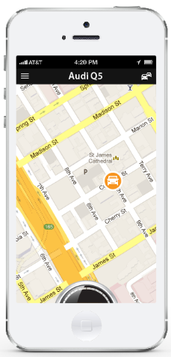
Fleet
December MTD
Total Cost Total Gals Used
$29.45
12.1
Avg. MPG Avg. $/Gal Avg $/Mile
22.7
$2.45
$.75
50%
Mom’s Audi
Insert placeholder graphic for cars that don’t transfer fuel tank data.
$/Mile $.95 $/g $ 2.45
MPG 22.7
Suzie’s Honda
$/Mile $.95 $/g $ 2.45
MPG 22.7
9%
Matt’s Dodge
$/Mile $.95 $/g $ 2.45
MPG 22.7
Highlight icon of feature that is in use so we can save real estate from titles, etc.

Slide 2



Fleet
Mom’s Audi
Export feature
Add date range & Calendar view and Totals to car list view.
Fleet
Suzie’s Honda
< December 2014 >
< December 2014 >
Total Miles
Time
Cost
Miles
Time
Cost
235.7
4 h 16 m
$294.45
235.7
4 h 16 m
$294.45
Mom’s Audi
December 2, 2014
$ 1.23
When user names a trip, default to that name going forward.
Do the same for the category.
Miles
Time
Cost
11 minutes
3 miles
235.7
4 h 16 m
$294.45
5:21 PM – Trip Name
1 min Work
$ .23
0.2 miles
>
Matt’s Dodge
Suzie’s Honda
Miles
Time
Cost
235.7
4 h 16 m
$294.45
Matt’s Dodge
Miles
Time
Cost
235.7
4 h 16 m
$294.45

Slide 3
Fleet
Mom’s Audi
Export feature
Add date range, calendar view, and Totals to car list view.
Fleet
Suzie’s Honda
< December 2014 >
< December 2014 >
Total Miles
Time
Cost
Miles
Time
Cost
235.7
4 h 16 m
$294.45
235.7
4 h 16 m
$294.45
Mom’s Audi
December 2, 2014
$ 1.23
When user names a trip, default to that name going forward.
Do the same for the category.
Miles
Time
Cost
11 minutes
3 miles
235.7
4 h 16 m
$294.45
5:21 PM – Trip Name
1 min Work
$ .23
0.2 miles
>
Matt’s Dodge
Suzie’s Honda
Miles
Time
Cost
235.7
4 h 16 m
$294.45
Matt’s Dodge
Miles
Time
Cost
235.7
4 h 16 m
$294.45

Slide 4

If user clicks on their own score, or the score of a linked driver/car, they should be taken to a history screen that lists activity.
Fleet
Mom’s Audi
Mom’s Audi
Score
101
6/1 Hard stop -10
10:02 am
6/2 Geo: Brickyard
11:24 am
6/25 10 mph over limit -10
3:03 pm
Fleet
Suzie’s Honda
Mom’s Audi
Mom’s Audi
Score
Geo-fence
101
Fence Name
Address
Suzie’s Honda
Score
233
Radius around address
10
Miles
Matt’s Dodge
Score
Notifications
451
Email:
primary@driver.com
SMS:
801-999-9999
Save

Slide 5

Fleet
Mom’s Audi
Mom’s Audi
Settings
+
Geo-Fencing
Brickyard In
Jr. High Out
Joey’s House In, Out
Fleet
Suzie’s Honda
Mom’s Audi
Mom’s Audi
Score
Geo-fence
101
MPH Threshold
Fence Name
90
Address
Suzie’s Honda
Score
Notifications
233
Instant Push:
Radius around address
Off
On
Email:
primary@driver.com
10
Miles
Matt’s Dodge
Score
SMS:
801-999-9999
Notify if traveling
451
Into the fence
Save

Slide 6
Geo-fence
Fence Name
Address
Radius around address
10
Miles
Notifications
Email:
primary@driver.com
SMS:
801-999-9999
Save

Slide 7

Matt’s Dodge
Matt’s Dodge
9%
Fill ‘er
Up
Find
Gas
9%
Fill ‘er Up
December MTD
December MTD
Total Gals Total $
MPG Avg. $/Gal Avg $/Miel
Total Gals Total $
MPG Avg. $/Gal Avg $/Mile
14.3
$55.12
20.1
$2.77
$ .95
20.1
$2.77
$ .95

Slide 8

Matt’s Dodge
Dec. 17, 2013 10:15am
Flying J
1544 So. State Street
Pleasant Grove, UT
Price/Gal:
# Gals:
$ 3.01
12.9
Total:
$ 38.83
Submit
15% off Valvoline Fuel Additive.
Free fountain drink with fill up.

Slide 9
Matt’s Dodge
Matt’s Dodge
+
-
+
-
Path

Slide 10
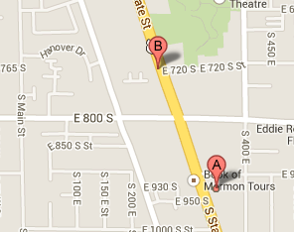
Mom’s Audi
Vital Stats
Alerts
P1300 Random Misfire
Most likely ignition coil is bad in cylinder 1
- Ignition Coil No. 1 harness is open or shorted - Ignition Coil No. 1 circuit poor electrical connection Learn More >>
Alerts
1
Start
Maintenance
History
Service Providers
Larry Miller Toyota Toyota of Orem Joe’s Car Repair
Promotions
Map
Get 10% off all car parts thru 2/13

Slide 11

Fleet
Suzie’s Honda
Mom’s Audi
Oil Change – 10,500 Miles
Oil Change – 10,500 Miles
Source: Edmund’s
Alerts
Save to Calendar
Date: June 1, 2013
1
Service Providers
Start
Maintenance
Suzie’s Honda
1
Rotate Tires – 4,000 Miles
Larry Miller Toyota Toyota of Orem Joe’s Car Repair
User clicks the reminder name to see/adjust detail
Map
History
Promotions
Wash Car – 1X per month
Get 10% off next oil change.
Matt’s Dodge
Save to Calendar

Slide 12
User clicks the reminder name to see/adjust dtail
Fleet
Mom’s Audi
9200 – Gas Cap open
Suzie’s Honda
4-23 – Tire pressure low

Slide 13
Fleet
New information that has not yet been viewed (Alerts, New maintenance recommendations) should appear on the main screen in some kind of dynamic bubble. Once the new information is viewed, the bubble should disappear.
Alerts
1
Start
3
Maintenance
History

Slide 14


Fleet
Scheduled Car Care
Mom’s Audi
June
Clicking on an event in the list will open the detail screen for editing, deletion, or to mark as complete.
4
Oil Change – 10,500 Miles
Suzie’s Honda
June
10
13
Rotate Tires – 4,000 Miles
Wash Car – 1X per month
The user should have the option to view scheduled tasks/events in the list view or open their phone calendar for a calendar view.
Create Task

Slide 15
Use color to mark items as scheduled vs. completed
Fleet
Allow user to export the selected history and email it.
June 2013
Mom’s Audi
June
Export & Email to:
4
Oil Change – 10,500 Miles
primary@driver.com
Suzie’s Honda
Cancel
Yes
June
10
13
Rotate Tires – 4,000 Miles
Wash Car – 1X per month

Slide 16
Suzie’s Honda
Suzie’s Honda
Oil Change – 10,500 Miles
Oil Change – 10,500 Miles
Date: June 1, 2013
Date: June 1, 2013
Time: 2:00 PM
Time: 2:00 PM
Service Providers
Service Providers
Larry Miller Toyota Toyota of Orem Joe’s Car Repair
Larry Miller Toyota Orem
Map
Payment
Promotions
Amount: $ 45.79
Get 10% off next oil change. Free tire rotation w/ Oil change
Receipt image:
Browse
June_1_receipt.jpg
Completed
Save

Slide 17
Fleet
Suzie’s Honda
Scheduled Car Care
Oil Change – 10,500 Miles
Mom’s Audi
Send Reminder:
June
Recurring # Miles
4
Oil Change – 10,500 Miles
5000
Suzie’s Honda
or
Date: June 1, 2013
June
Email:
primary@driver.com
10
13
Rotate Tires – 4,000 Miles
SMS:
801-222-3333
Wash Car – 1X per month
Create Task
Save

Slide 18
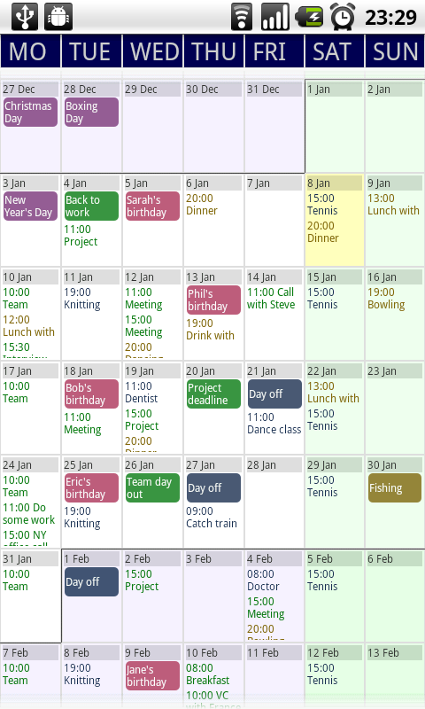

Slide 19



Matt’s Dodge
Clicking on the name, pic or anywhere in the white box, should open the detail screen for editing.
Tessa - Soccer
Give users a button they can drag to change order of the list.
Shawna P
9500 W. Oak Dr.
Petersons
2323 Honeycut Ct.
Max’s House
43 E. 2000 W.
Add Stop

Slide 20

Tessa - Soccer

Slide 21




Fleet
Fleet
Suzie’s Honda
Mom’s Audi
1515 Mercy Lane
Salt Lake City, UT 84109
101
Fuel
Safe Driver Score
Tire Pressure Low
9%
Suzie’s Honda
1515 Mercy Lane
Salt Lake City, UT 84109
24
Fuel
Safe Driver Score
Oil Pressure Low
19%

